Slide 1
Reporting Administrative Team Input Session
Thoughts on Budget Cuts to Address Our Ongoing Deficit
(42 participants)

Slide 2
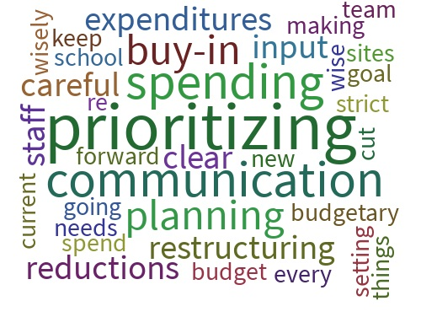
FACTORS (admin) For Success Clear Communication Prioritizing/Planning Careful Spending

Slide 3
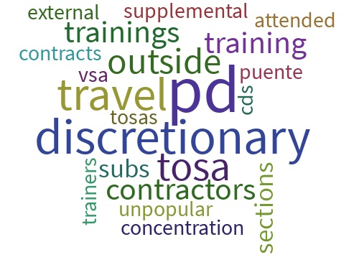
CUTS (admin) We can support Discretionary Cuts Travel Cuts Professional Development Cuts

Slide 4
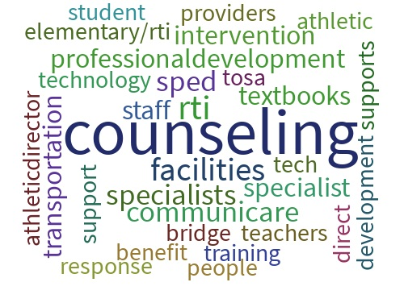
TOP (admin) Service areas to keep Counseling Staff Facilities RTI Staff

Slide 5
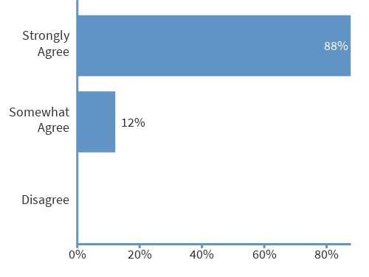
THOUGHTS (admin) Cutting vacant positions

Slide 6
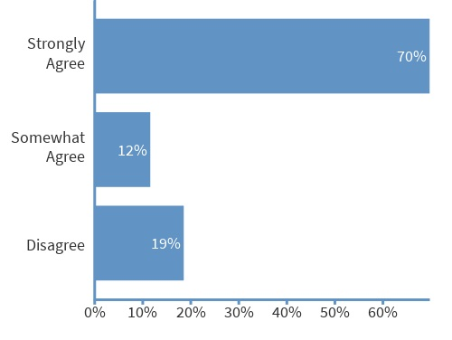
MATH & ELA (admin) TOSAs for PD

Slide 7
MAXIMIZE (admin) Staffing ratios

Slide 8
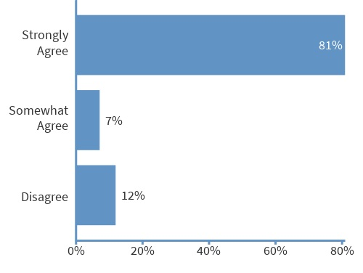
SITE DISCRETIONARY CUTS (admin) vs Cutting Staff

Slide 9
Reporting All Staff Input Survey
Thoughts on Budget Cuts to Address Our Ongoing Deficit
(371 participants)

Slide 10
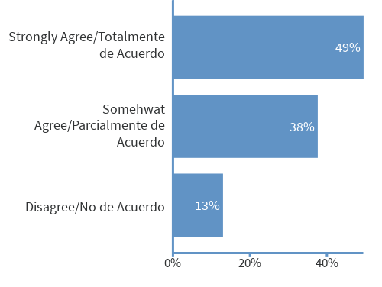
THOUGHTS (all staff) Cutting vacant positions

Slide 11
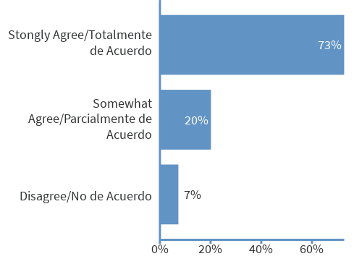
THOUGHTS (all staff) Reducing vendor contracts

Slide 12
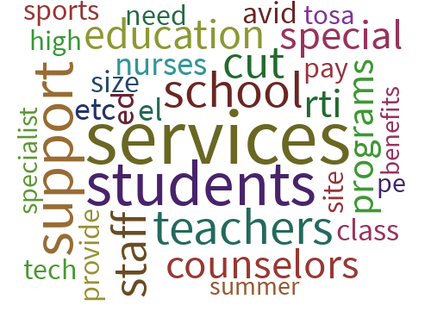
TOP (all staff) Service areas to keep Student Support Services Teachers Counselors

Slide 13
Themes (all staff) What to reduce/ cut (open-ended)
Ed Services
Secondary Prep/sections/ staff
D.O./ staff/ TOSAs
RTI/PBIS
Major Themes
Non-essential materials
Field trips/ overnight trips
SPED
Outside vendors
Minor Themes:
Discretionary funds
Music
Extra duty/ OT
Technology dept.
Enrollment services
After school
M&O
Transportation
PD/ training/ conferences
Athletics/ stadium

Slide 14
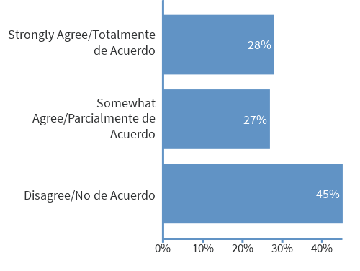
THOUGHTS (all staff) Maximizing staffing ratios

Slide 15
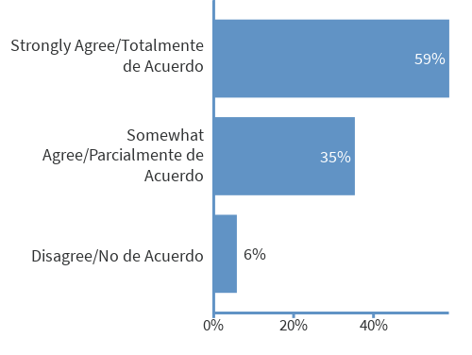
THOUGHTS (all staff) Cutting discretionary funding vs. staff

Slide 16
Reporting LCAP Collaborative Input Survey
Thoughts on Budget Cuts to Address Our Ongoing Deficit
(24 participants)

Slide 17
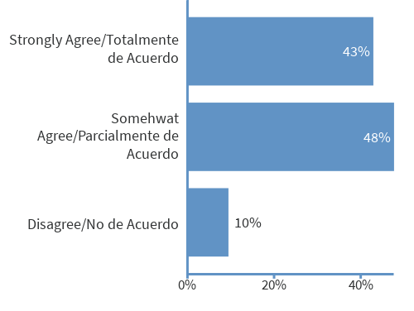
THOUGHTS (LCAP) Cutting vacant positions

Slide 18
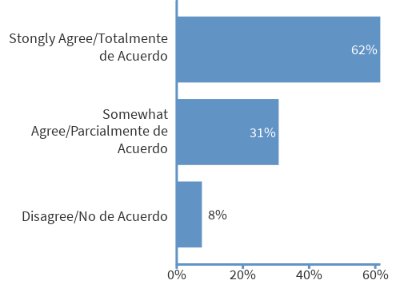
THOUGHTS (LCAP) Reducing vendor contracts

Slide 19
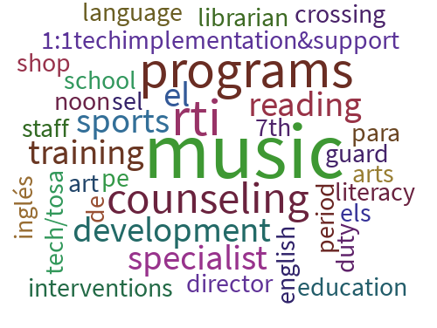
TOP (LCAP) Service areas to keep Music Programs Counselors

Slide 20
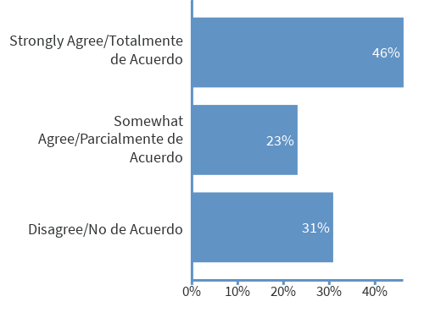
THOUGHTS (LCAP) Maximizing staffing ratios

Slide 21
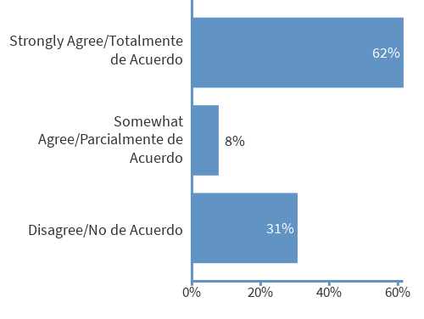
THOUGHTS (LCAP) Cutting discretionary funding vs. staff

Slide 22
Reporting DELAC Input Survey
Thoughts on Budget Cuts to Address Our Ongoing Deficit
(16 participants)

Slide 23
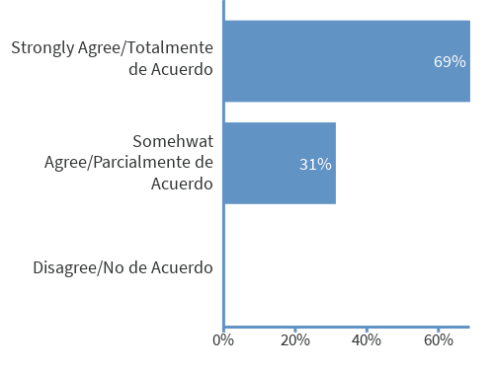
THOUGHTS (DELAC) Cutting vacant positions

Slide 24
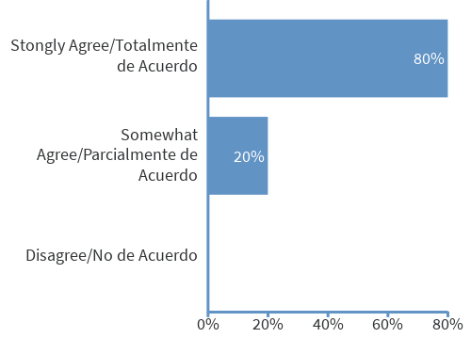
THOUGHTS (DELAC) Reducing vendor contracts

Slide 25
TOP (DELAC) Service areas to keep EL Services Teachers Counselors/ Nurses

Slide 26
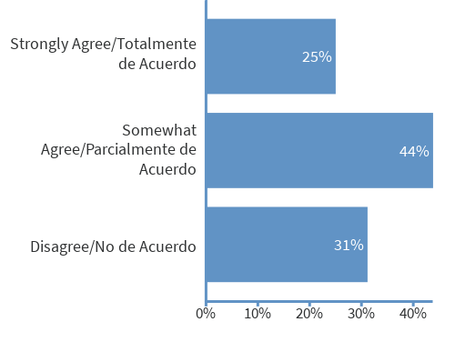
THOUGHTS (DELAC) Maximizing staffing ratios

Slide 27
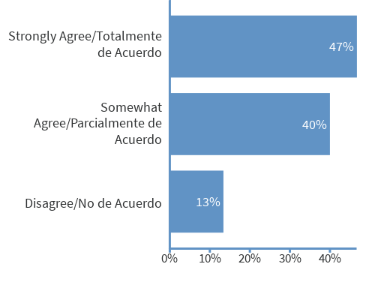
THOUGHTS (DELAC) Cutting discretionary funding vs. staff

Slide 28
STATUS SUMMARY
The surveys/ discussions were designed to capture feedback that would help inform a balanced cohesive recommendation from the Executive Cabinet that would best serve the students of WJUSD.

